Slide 1
promotion terms
Sales force promotions
Trade shows
Consumer promotions
Coupons
Premiums
Deals
Incentives
Product samples
Sponsorship
Promotional tie-ins
Product placement
Loyalty marketing programs
Online loyalty marketing
Point-of-purchase displays
Audience
Frequency
Impression
Advertising Campaign
promotion
Product promotion
Institutional promotion
Advertising
Visual Merchandising
Public relations
News release
Publicity
Promotional mix
Sales promotions
Trade promotions
Promotional allowances
Cooperative advertising
Slotting allowances

Slide 2
Promotion Collage
Pick one of the following forms of promotion to explain on a 1 page PowerPoint or Poster.
Research the promotion 25 pts.
Create a collage to describe the type of promotion 50 pts.
Give at least 5 examples of the type of promotion with pictures 25 pts.
Sponsorships
Promotional tie-ins
Product placement
Loyalty marketing programs
Point-of-purchase displays

Slide 3
Promotional Tie-In
A joint promotion of two or more products or services.
For example, boxes of Post Great Grains cereal included a free trial package of Starbucks coffee as a value-added item for consumers.
The tie-in promotion was intended to increase sales of both the cereal and the coffee.

Slide 4
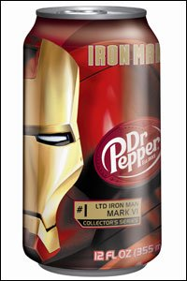
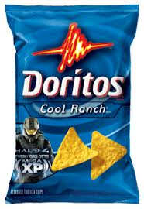
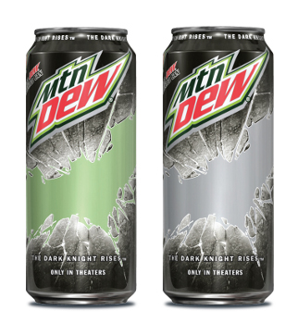
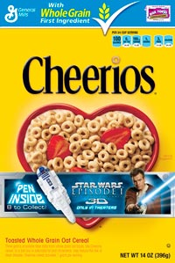
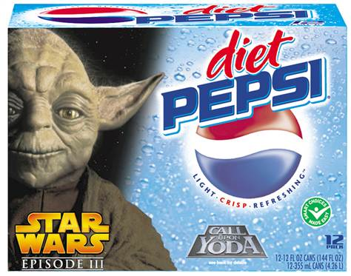
Promotional Tie-ins
By: Alex Coker, JaVahnne Rhodes, Kyree Smith
Definition: Involve sales promotional arrangements between one or more retailers or manufacturers.
Ex: Dr. Pepper and marvel are promoting their iron man movie.
Ex: Doritos and the game developers of Halo are using promotional tie-ins by offering free xp in Halo if you buy Doritos.
Ex: The Dark Knight is using Mtn DEW to promote their new movie.
Ex: Star Wars is using Cheerios to promote their new movie by putting toys in the cereal.
Ex: Star Wars is using Pepsi to promote their movie.

Slide 5
Sponsorships
Sponsorship is not the same as advertising
Sponsorships provide a lateral partnership between 2 parties
It is a form of marketing in which companies attach their name, brand, or logo to an event for the purpose of achieving future profits
For example, major corporations sponsored the NCAA college football bowl games recently

Slide 6
Product Placement
The majority of us are getting tired of ads. Today's consumer sees advertising everywhere: tv, radio, billboards, magazines, buses, newspapers, the Internet...
More and more ad-space is popping up every day. From people walking down the street wearing signs, to flyers on our cars and in our mailboxes, to ads on the ATM screen as we wait for it to dispense our cash -- we see ads all day, every day.
When is an ad not an ad? When it's a product placement. Once mainly found only on the big screen, product placement has been making quite a few appearances on TV -- not to mention in video games and even books.
New Superman movie (most commercialization ever), “Ad-free” 24

Slide 7
Point of Purchase Displays
The customer is thinking about a particular product but often they are drawn to the one which is displayed in a more prominent fashion without knowing.
Well done point of purchase (POP) displays will draw consumers to one product over another, or give one store a better image (visual merchandising).
POP display often carry impulse purchases that have a higher markup %!
Usually near the checkout counter
Gum, drinks

Slide 8
Loyalty Marketing Programs
BUILD A RELATIONSHIP WITH YOUR CUSTOMER!
Customer loyalty is all about attracting the right customer, getting them to buy, buy often, buy in higher quantities and bring you even more customers.
VIP and loyalty program members are 70% more likely to spread the word about your business.
65% want stores they want to frequent to email them coupons and promotions.
The probability of making an additional sale or upselling to loyal customers is 60-70%.
Compared with loyal customers, new ones are more price-conscious. The chances of getting a sale from a new person is 5 to 20%. And actual sales from promotions sent to them is less than 1%.
JOIN from web or mobile. Connect via Facebook or Twitter. Get ready to be rewarded for your brand loyalty. Being Social has its advantages!

Slide 9
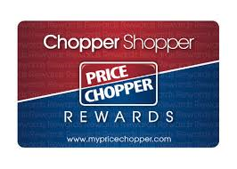
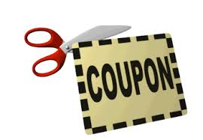
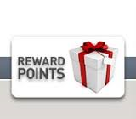
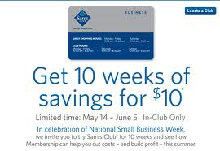
Loyalty Marketing Program
Def: A marketing approach in which companies focus on growing clientele through incentives.
5 Examples of Loyalty Marketing:
1.) Coupons- Discounts on certain items
2.) Reward Points Card- What they scan when you purchase an item to gain reward points
3.) Reward Points- Going to the internet and buying things with reward points for shopping there
4.) Premium Membership- Special discounts when becoming a member of store
5.) Deals- Buying 3 tires and getting the 4th one free

