Slide 1
Product Planning
Chapter 30, 31, and 32

Slide 2
Quiz today
You have 10 minutes to review the new product development flow chart and number 22-27 in your notebook.

Slide 3
What is A Product?
Anything a person receives in an exchange.
Goods- tangible
Services- intangible
Three Levels to each product
Core Product
The benefit that a customer will receive from the product.
This is not tangible
Ex: Core product for cereal: Satisfies hunger
Actual Product
The tangible, physical product
Color, quality, brand, features, etc.
Augmented Product
The non physical part of the product. Adds value or extends the product
Warranties, customer care, installation, services, delivery

Slide 4
Product Planning
Determining what goods and services you will have e to sell.
Typically, companies don’t just offer ONE product. They develop a Product MIX
Product Mix: all the different products a company makes or sells
Product Lines: group of closely products
Product item: a specific item within a line

Slide 5
Product Depth and Width
Product Width: number of different product lines
Product Depth: number of items offered within each line
Let’s Look at Coca Cola and Pepsi

Slide 6
Assignment
You will be assigned a company, you are to look at the company website determine their width and depth
Graphically represent those as shown on board.

Slide 7
Product Mix Strategy
A plan for determining which products a business will make and stock.
3 mix strategies
Develop new products
Develop existing products
Product modifications
Deleting a product or line

Slide 8
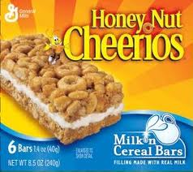
Product Mix Strategies
Develop New Products
7 steps to product development
VERY EXPENSIVE

Slide 9
7 Steps of New Product Development Flow Chart
Utilizing Chapter 30 in your book
Create a flow chart to represent the 7 steps in product development.
Title your Flow Chart
Label and Number each Step
Complete a minimum of 3 bullets that detail what occurs in each step
Draw a picture that represents each step
Use color to visually separate each step
Make sure that you read for comprehension

Slide 10
New Product Development
Generate Ideas
Screen Ideas
Develop a Business Proposal
Develop the Product
Test the Product
Introduce the Product
Evaluate Customer Acceptance

Slide 11
New Product Assignment
Identify one new product that your company has introduced in the last year. Create a PowerPoint slide for the new product.
Picture of product
Name of product
When introduced
Description of product: (copy exactly as they word it)
Create a Feature/Benefit Chart for the new product (must have at least 3)
Identify the Augmented Product
Retail Price of product
Promotional messages found (at least 2)
Save your PowerPoint, we will be adding to it.

Slide 12
Managing During the PLC
On a Blank Sheet of Computer Paper. Draw the Product Life Cycleand fill in sales characteristics and marketing strategies for each section. Make sure you label each stage and title the cycle.
As you read pages 643 to 645 fill in your chart.

Slide 13
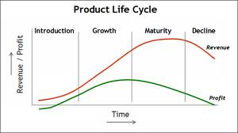
Product Life Cycle

Slide 14
Product Mix Strategies
Develop Existing Products
Constantly reviewing products to see if they need modifying, or extensions.
Line Extension- Cheerios cereal, extended into on the go breakfast bars
This is different than product extension

Slide 15
Product Mix Strategies
Deleting a Product or Product Line
Must pay attention to Product
Sales increasing or decreasing
Loss of Appeal
Must pay attention to Product Life Cycle
Decline Stage, Obsolescence stage
Must pay attention to Company Objectives

Slide 16
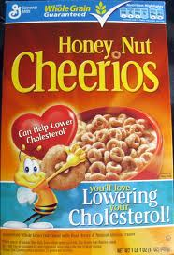
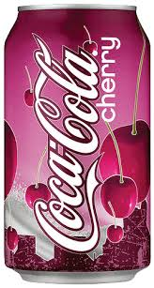
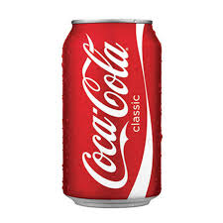
Line Extension Cereal Line to Breakfast Bars Line
Product Extension
Beverage Line to Beverage Line

Slide 17
Group Assignment
Open your New Product Launch PowerPoint, add the following to it.
Modifying/Extending Products
Each person in your group must identify one line extension and one product extension. Create a one slide visual display for each person’s examples
Product Deletion
Identify one product that your company has deleted recently. Create one slide that outline the following.
Identify when it was initially launched
When it was discontinued
A picture
Determine why it was discontinued (research and read to find out)
Save your PowerPoint and email it to me at nhsmarketing2002@gmail.com with the subject line Name(s)ProductMixStrategies

Slide 18
Presentations and Review
Presentations of Product Mix Strategies
Workbook Pages
261 and 262

Slide 19
Product Positioning
The image that the product projects.
Set product apart from the competition
Product Positioning Video
Ways to Position
Positioning by Statement
Positioning by Market Segment
Positioning based on Magic, Emotion, and Stories
Positioning by social Approval
Positioning against competition
Repositioning
Positioning by price
Positioning by name
Positioning by unique attribute.

Slide 20
Positioning Challenge
From Magazines find three examples of three different positioning types.
Tear out the ad
Answer the following questions for each ad
Magazine
Brand
Type of Positioning used

Slide 21
Branding, Packaging, and Labeling

Slide 22
Branding
Important part of product planning
Brand: Name, Term, Design, symbol or character that identifies a product or service.
Like a personality to a human

Slide 23
Elements of a Brand
Brand name
Trade name
Trade character
Trademark
Brand mark

Slide 24
Brand Name
AKA- product name
Word or group of words that represent a product
Should be easy to remember and to pronounce
May be used to position a product.
Positioning by name!
Examples: PT Cruiser, Barbie, Big Mac, SnackHealthy

Slide 25
Trade Name
AKA- Corporate Brand
Identifies or promotes a company
Legal name of company
Promote Positive image
Keep free from negative connotations
Examples: Nike, Kellogs, Disney

Slide 26
Brand Mark
Unique symbols, coloring, lettering, or other design used
Strong brand mark= recognizable without words.
Logos’ are a brand mark
Makes shopping easier
Must be suitable, creative, and memorable

Slide 27
Trade Character
A specific type of brand mark
One with human forms or characteristics

Slide 28
Trade Mark
Anything that is legally protected.
Prevent other companies from using similar elements that might confuse a customers.
You can trademark your brand, brand mark, and trade character.

Slide 29
Why are brands important?
Establishes an image for company
Builds recognition and customer loyalty
Ensures quality and consistency
Helps allows companies to extend products later

Slide 30
Brand Names
75% of all companies introduce new products every year
Must research to ensure name isn’t already in use.
Once brand has been generated and research, companies will conduct research to gage brand effectiveness.

Slide 31
Branding Strategies
Brand Extensions
Use an existing brand to promote a new or improved product
Example- Ocean Spray Cranberry Juice
Cran-Apple, Cran-Cherry, etc.
Brand Licensing
Allowing other companies to use your brand, brand mark, or trade character.
Mixed-Brand
Combination branding
Co-Branding
Combining brands
Smucker’s filled Kellogg's Pop Tart

Slide 32
Cereal Project- Stage 2
New Product Development Steps 1-3 (1day)

Slide 33
Cereal Project- Stage 2
Step 4 new product development
Create your brand name/logo with slogan (1 day)

Slide 34
Cereal Project Stage 2
Product Development- Poster Creation. (2 days)

Slide 35
Packaging and Labeling

Slide 36
Packaging
Physical container or wrapping for a product
Integral part of product planning and promotion
10% of a products retail price is spent on packaging
$100 pair of shoes, $10 was for the box that you throw away!!!!

Slide 37
Functions of Packaging
Promote and sell
Provide information
Protect product
Ensure safe use
Express customer needs
Create identity

Slide 38
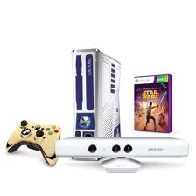
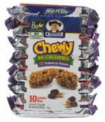
Promote and Sell
Attractive, colorful, and visually appealing packages sell better
Packaging bundling
Mixed bundle
Price bundle

Slide 39
Define Identity
Promote image
Prestige
Convenience
status

Slide 40
Provide Information
Directions for use
Information about content
Product guarantees
Nutritional value
Potential hazards

Slide 41
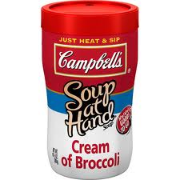
Express Customer Needs
Various sizes
Family pack
Individual size
On the go
Get innovative to better meet
customers needs!!!!

Slide 42
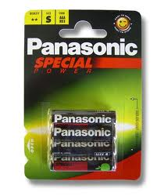
Ensure safety
Must be safe for customer
Using plastic instead of glass
Tamper resistant tops (child proof)
Blister packaging- molds with backing

Slide 43
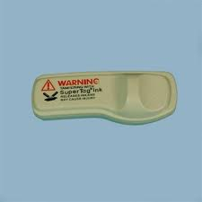
Protect the Product
During shipping, storage, and display
Prevent tampering, shoplifting
Prevent spilling, breakage, spoiling

Slide 44
Trends in Packaging
Aseptic Packaging
Environmental Packaging
Cause Packaging

Slide 45
Labeling
Label: information tag, wrapper seal, or imprinted message that is attached to a product
Inform customers about product content
Gives direction
Protects businesses from legal liability if injury occurs
McDonalds Coffee Example

Slide 46
Types of Labels
Brand Label
Gives brand name and logo
Descriptive label
Gives information about product use, construction, care, performance and features.
Nutrition label
Best by dates
Grade label
Quality label
Grade A eggs

Slide 47
Labeling Laws
Name and Address of manufacturer, packer or distributor
Quality contents
Cannot be misleading or deceptive
Fair Packaging and Labeling Act

Slide 48
Packaging the Science of Temptation
Video with questions

Slide 49
Warranties
A promise or guarantee given to a customer that a product will meet certain standards
Express warranty
Full warranty
Limited warranty
Implied warranty
Warranty of merchantability
Warranty for fitness for a particular product
disclamer

