Slide 1
Marketing During the Holidays Bellringer
Name at least 5 ways that businesses promote their products/services during the holidays?

Slide 2
UNIT C
The Business of Fashion
3.01 Explain the concept of marketing in fashion.

Slide 3

Marketing
The process of developing, promoting, pricing, and distributing products in order to satisfy customers’ needs and wants.
Marketing involves the total process of finding or creating a profitable market for specific goods or services.
How will we market P3 for the Holidays?

Slide 4
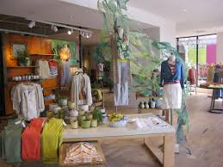
Fashion merchandising
Specific marketing activities designed to have fashion-oriented merchandise at the right time, place, quantity, and price to meet customer demand.

Slide 5
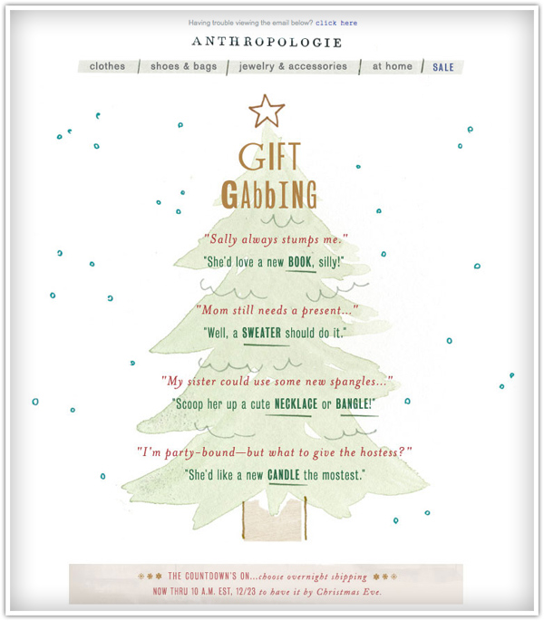
Marketing concept
A business approach that directs all marketing efforts towards customer wants and needs.
Customer needs must be determined before goods can be produced.

Slide 6
What do our customers want offered this Holiday Season?
Small gift item ideas?
Custom ideas?

Slide 7
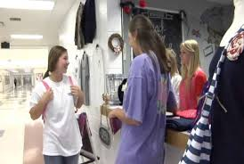
Market
The group of all potential customers.
Similar needs and wants
Willingness and means to satisfy those wants
Businesses must understand who their potential customers are in order to efficiently meet their needs and wants.

Slide 8
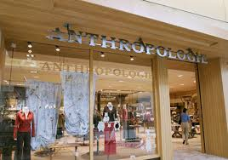
Target market
The specific segment of a total market that a company desires to have as customers and toward whom it directs its marketing efforts.
It is important that each fashion company carefully define its target market in order to make or carry products directed toward that market.

Slide 9
Market segmentation
Dividing the entire market into smaller groups having similar characteristics.
Every business must decide which customers it can serve in order to be successful.
Businesses must identify those customers to whom they can sell the most and maximize profits.
Demographic segmentation
Psychographic segmentation
Geographic segmentation
Behavioral segmentation

Slide 10
Demographic segmentation
A way to segment markets based on vital statistics of the population.
Age
Race
Gender
Education level
Income level
Occupation

Slide 11
Psychographic segmentation
A way of segmenting a market based on a consumers’ lifestyles, values, attitudes, and self-concepts.
Tries to explain consumer behavior and determine what the consumer is thinking and feeling
Behavior may be influenced by cultural background or social group

Slide 12
Geographic segmentation
Segmenting a market based on where a person lives.

Slide 13
Behavioral segmentation
Dividing consumers into groups according to their response to a product.
Groups consumers into categories based on what they are looking for in a product and why they buy the product
The marketer might consider what benefits the consumer wants, the consumer’s rate of use of the product, loyalty to a particular product or brand, and response related to a special occasion.

Slide 14
Marketing mix
A combination of decisions a business must make in order to best reach its target market; known as “the four Ps” of marketing.
Product
Place
Price
Promotion

Slide 15
Product considerations
Marketers must decide what goods or services are in demand and bring those products to the consumer.
What products/services should we offer during the Holidays at P3?
Choice of products
Brand name
Level of quality
Packaging
Warranties

Slide 16
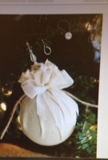

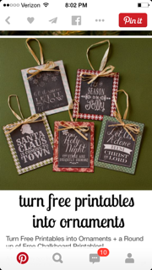
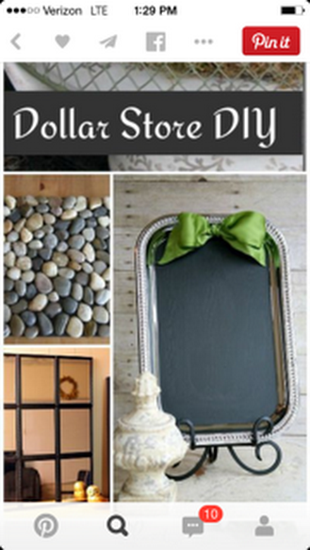
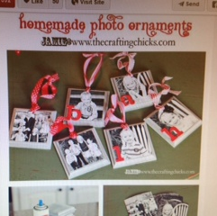

Products
Get in groups of two to find a product that you will create to sell at the school store! Then come up with a brief 30 second commercial for your product!
This will be due on Friday!
Think Free!!

Slide 17
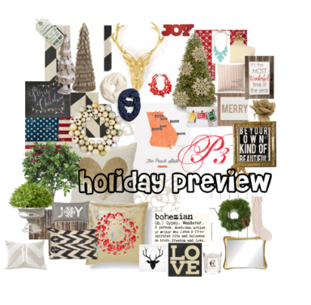
Create a P3 Holiday Preview Board
Log in to polyvore using
northsidefas – username
  Northside2002 – password
Mix décor, fashion, jewelry, etc. that you would like to see in our school store (items we may could replicate or buy) *Click Create Set
Add text to your set
  *Required – P3 Holiday Preview by (your name)
Publish your set (click top left corner)
I will have Mrs. Styers view the sets to pick a winner! The winner will serve as the merchandiser for the holidays at P3 for the next 3 weeks!!

Slide 18
Place considerations
Marketers must make products available at the right time and location.
How and where will products be offered to customers?
What method will be used to get products from producer to consumer?
What is the most efficient method of transportation?

Slide 19
Distribution Channels
Direct distribution: A distribution channel in which the producer sells goods or services to the final user.
  Example: A button manufacturer sells directly to garment manufacturers.
Indirect distribution: A distribution channel in which goods or services are sold indirectly to the consumer through one or more intermediaries.
  Manufacturer/producer to retailer to consumer (path that most fashion apparel takes.)
  Example: Levi Strauss sells jeans to Belk who, in turn, sells to the consumer.

Slide 20
Price considerations
Marketers must decide on an amount to charge customers for their products.
Affected by supply and demand
Cost of producing the item
Markup
Terms of sale such as credit and/or discounts

Slide 21
Promotion
Communication that informs, reminds, and persuades customers of the goods and services available to them.
Advertising
Publicity
Personal selling
Public relations

Slide 22
People
Many businesses also consider “people” (employees) to be an important element in the marketing mix since they can make the difference between success and failure by the way they carry out the other elements of the marketing mix.

Slide 23
Marketing functions
Distribution
Financing
Marketing-Information Management
Pricing
Product/Service management
Promotion
Selling

Slide 24
Distribution
The transporting, storing, and handling of goods on their way from the manufacturer to the consumer.
*Referred to as PLACE in the marketing mix.

Slide 25
Financing
Obtaining the money needed to cover the costs of operating a business.

Slide 26
Marketing-Information Management
Obtaining information about what consumers want.
Example: Marketing research

Slide 27
Pricing
Determining a value to charge for goods and services.
Price must cover
Costs of conducting marketing research.
Costs of financing the business.
Costs of producing the product.
Costs of promoting the product.
Costs involved in distributing the product.
Costs of selling the product to the final consumer.
Profit for all people involved in the marketing process.

Slide 28
Product/Service Management
Concepts and procedures necessary in designing, producing, maintaining, improving, and obtaining products or services to meet customer needs.

Slide 29
Promotion
Communication used to inform, persuade, or remind people about a business’s products.

Slide 30
Selling
Determining customer needs and wants and responding to those needs and wants through planned, personalized communication intended to influence purchase decisions and ensure satisfaction.

